Slide 1
Mongoose ODM

Slide 2
Objectives
Define and construct Mongoose schemas and models
Interact with MongoDB server using Mongoose from the Node application

Slide 3
What Mongooes ODM?

Slide 4
Mongoose ODM
MongoDB stores data in the form of documents
No structure imposed on the document
Any document can be stored in any collection
Relies on developer’s discipline to maintain the structure of the documents
Mongoose ODM
Object Data Model
Object Document Mapping
Object relational mapping (ORM)
Adds structure to MongoDB documents through schema

Slide 5
Mongoose Schema
Schema:
Structure of the data to be stored
Defines all the fields of your document and their types
Can do validation
Schema types: String, Number, Date, Buffer, Boolean, Mixed, ObjectId, Array
Schema is used to create a Model function
Schemas can be nested to enable supporting embedded or subdocuments

Slide 6
Install Mongoose ODM and connect to a MongoDB Server

Slide 7
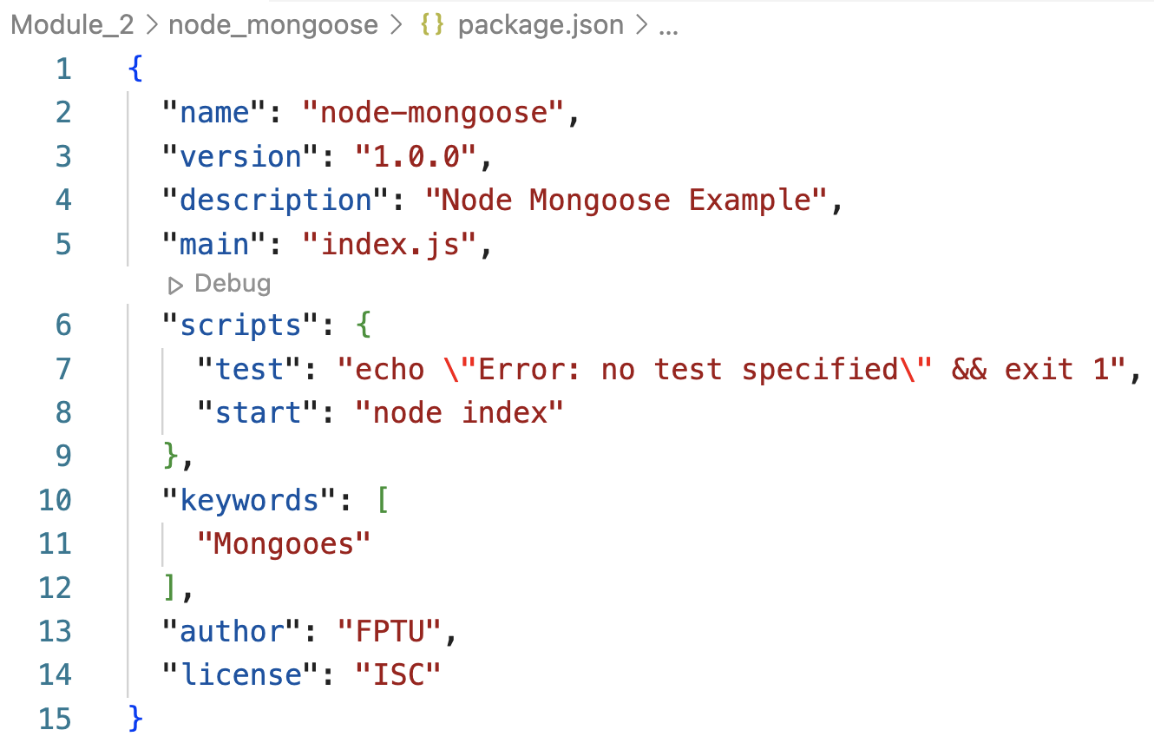
Installing Mongoose
Create a folder named node-mongoose and move into the folder.
At the prompt, type the following to initialize a package.json file in the node-mongoose folder:

Slide 8
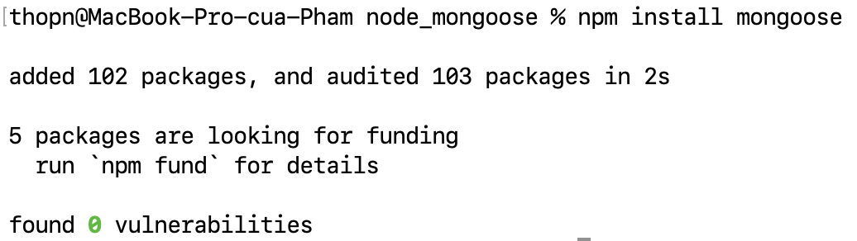
Installing Mongoose
In this folder, install Mongoose by typing the following at the prompt:

Slide 9
Implementing a Node Application
Create a sub-folder named models in the node-mongoose folder. Move to this folder.
Create a file named dishes.js and add the following code to create a Mongoose schema

Slide 10
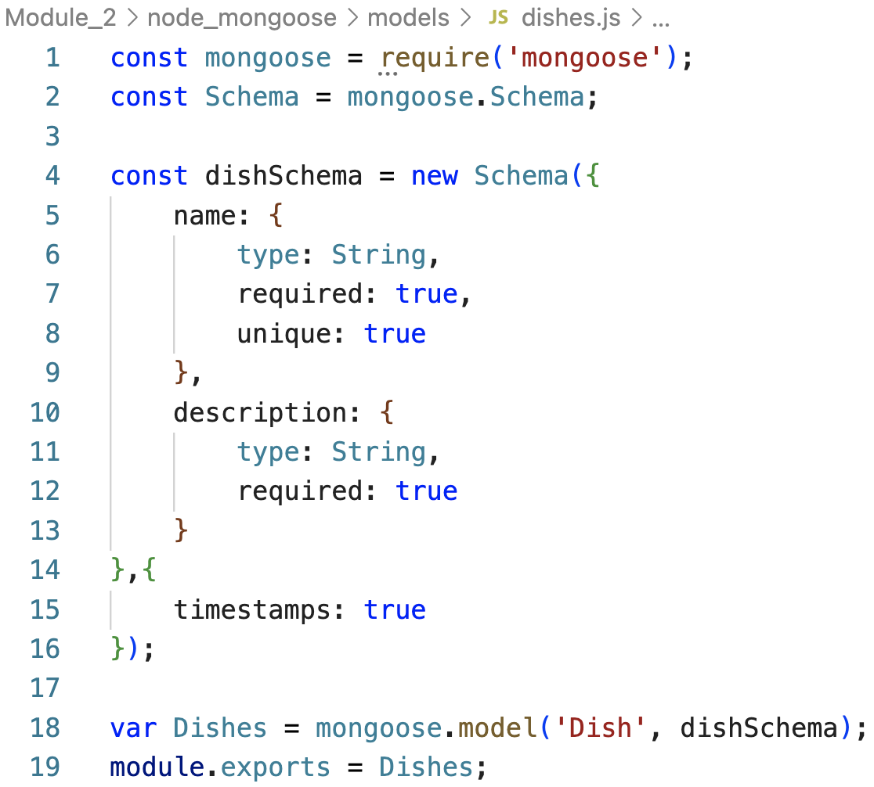
Create Mongoose Schemas
dishes.js:

Slide 11
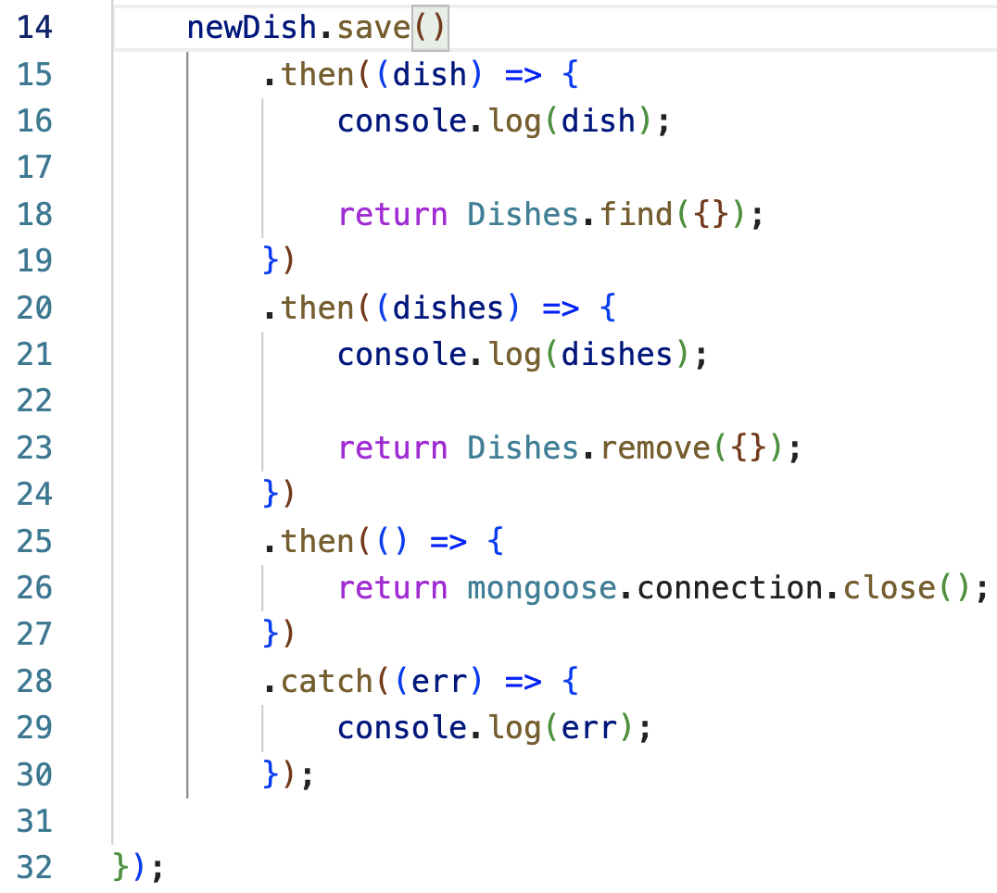
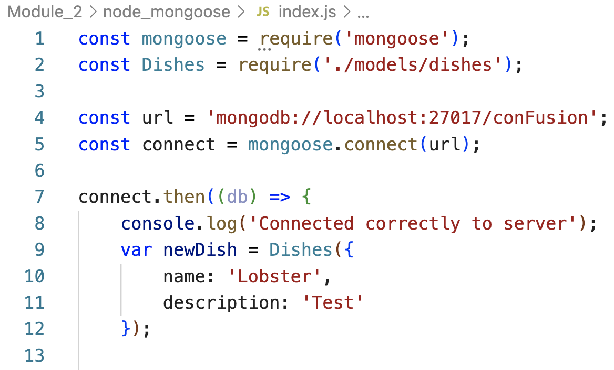
Perform Database operations (CRUD) with Mongoose methods
Move to the node-mongoose folder and create a file named index.js and add the following code:

Slide 12
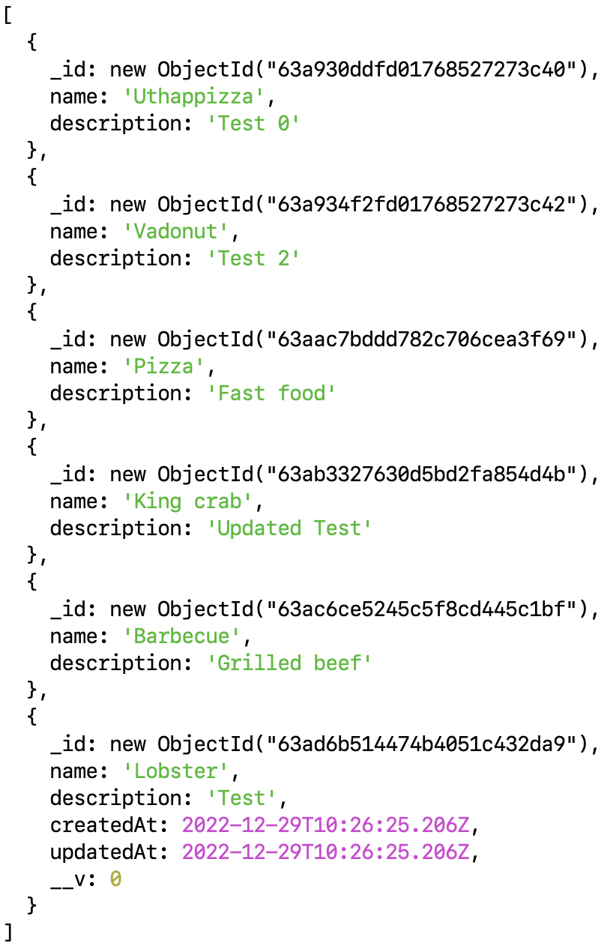
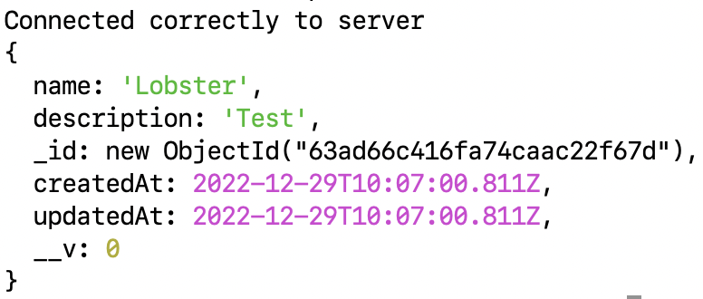
Run Node application
Make sure that your MongoDB server is up and running. Then at the terminal prompt type the following to start the server and see the result:
npm start

Slide 13
Adding Sub-documents to a Document

Slide 14
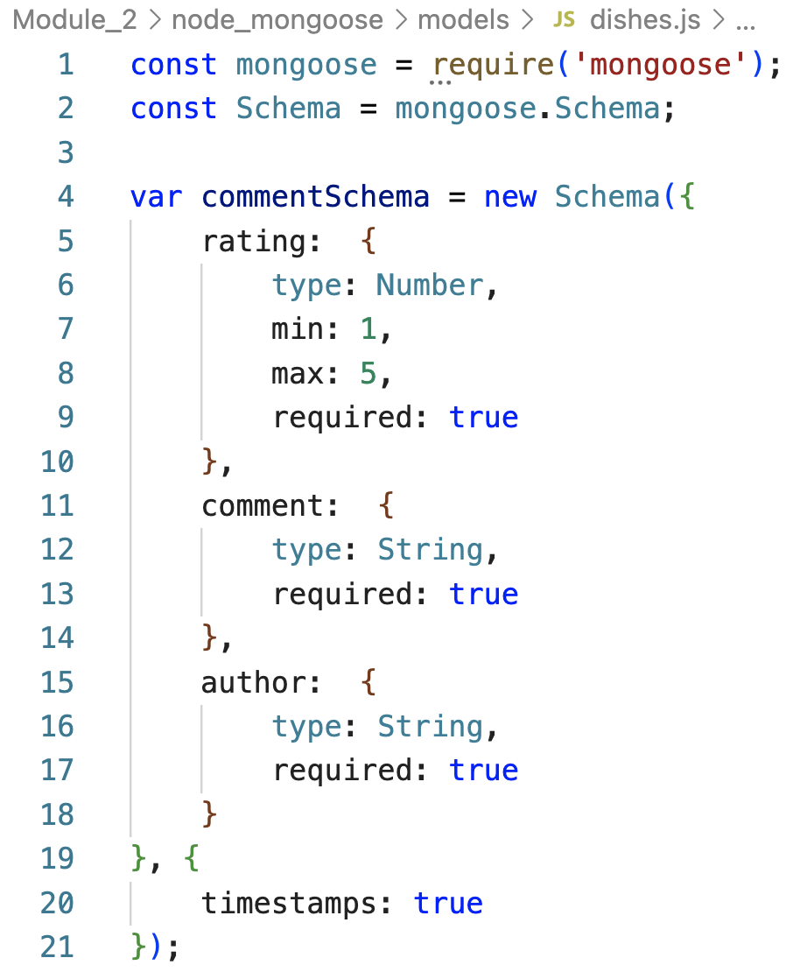
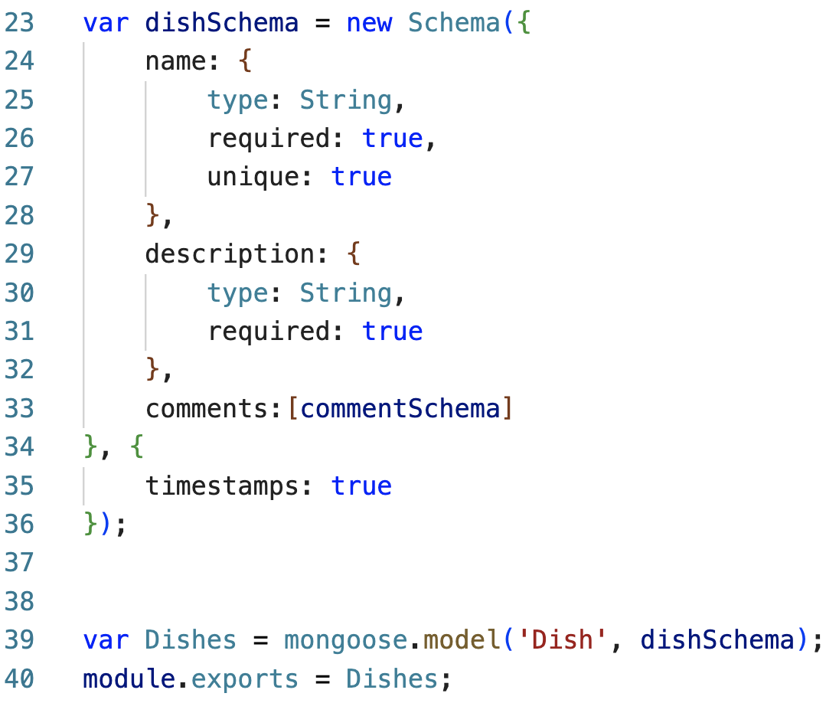
Add a Sub-document
Update dishes.js in the models folder as follows:

Slide 15
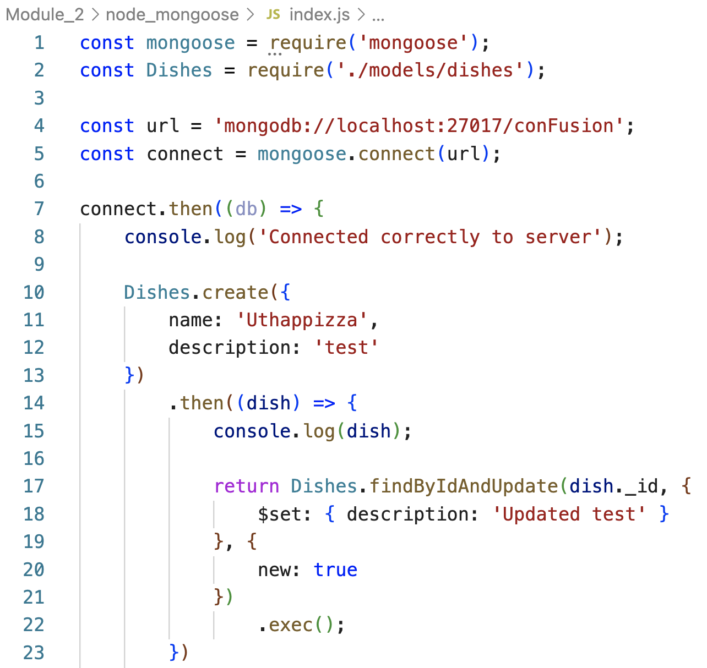
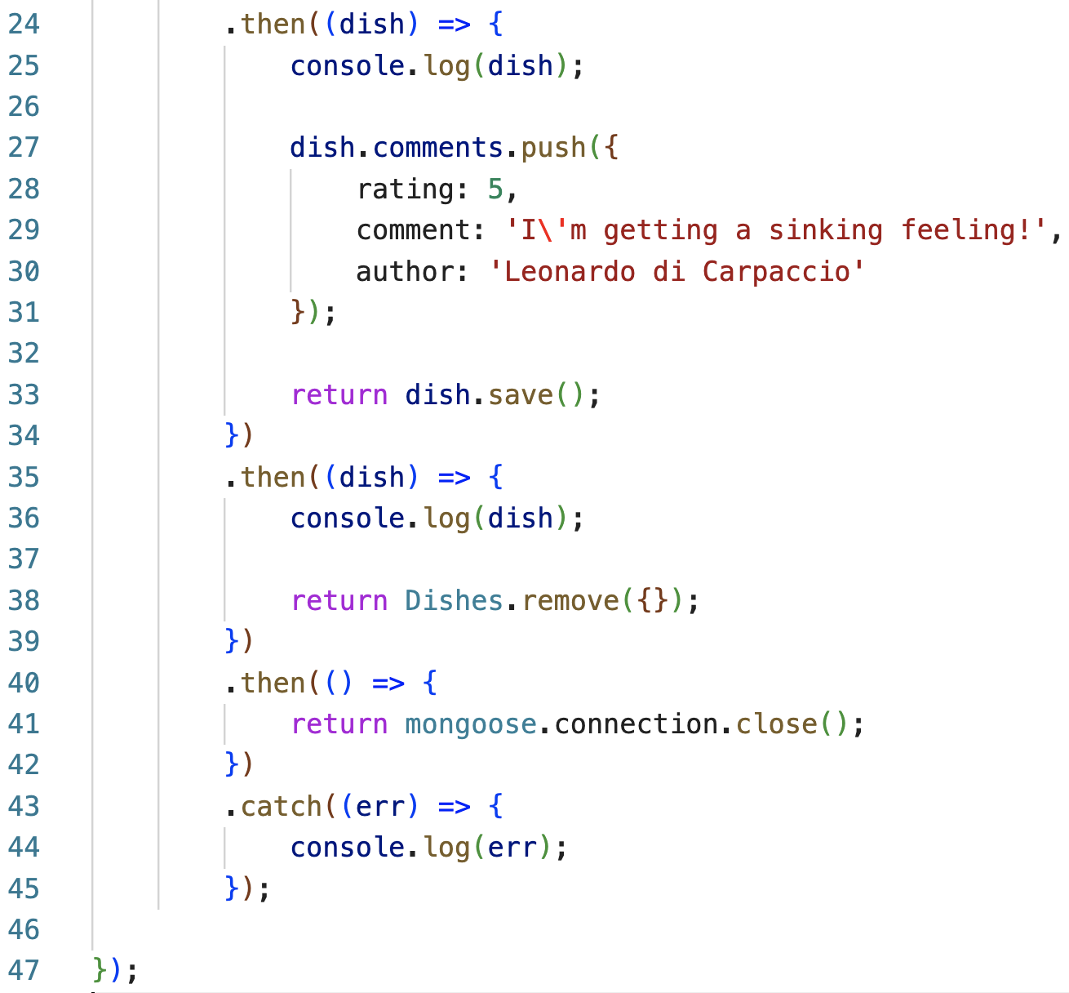
Add a Sub-document
Update index.js in the models folder as follows:

Slide 16
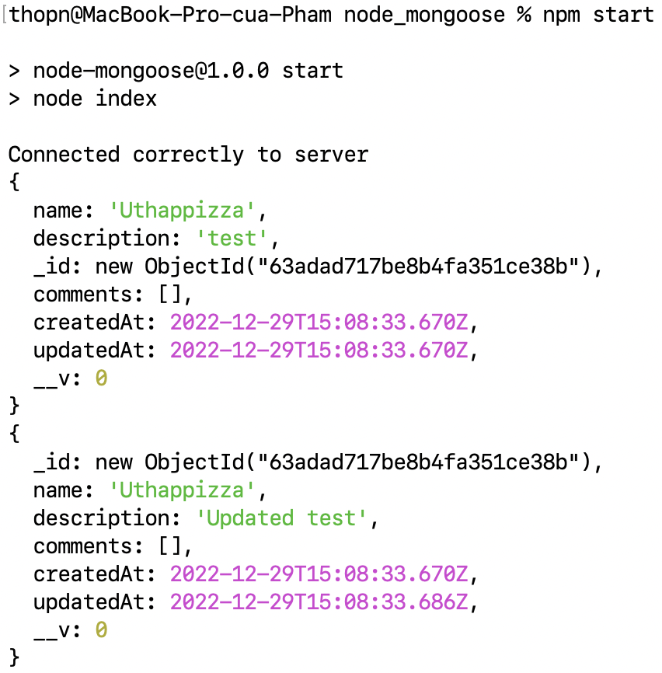
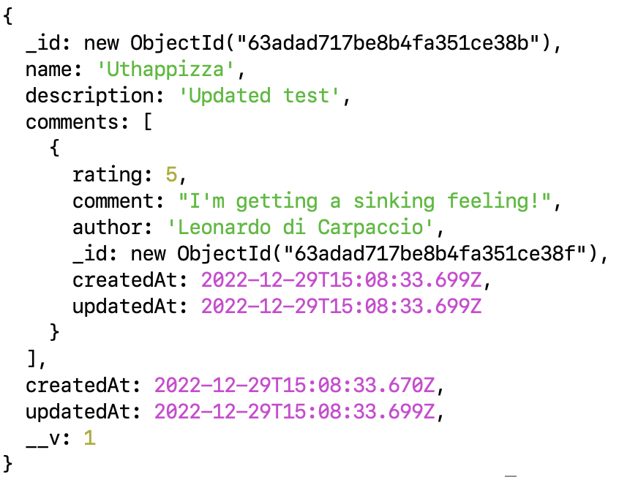
Run Node application
Run the server and observe the result.

Slide 17
Summary
Understand Mongoose ODM
Step by step to define and construct Mongoose schemas and models
Understand using Mongoose to interact with MongoDB server from the Node application

